Slide 1
Texas Esthetician License Analysis

Slide 2
Objective
The objective of this project is to clean the data from the data sources and join the data together to obtain the amount of Esthetician Licenses in each county in the state of taxes using the programming language R.

Slide 3
Data source
The data will be from these sources. The first source is from the state of texas license files, and the second source is the financial data for all U.S states.
https://www.tdlr.texas.gov/LicenseSearch/licfile.asp
https://data.census.gov/cedsci/

Slide 4
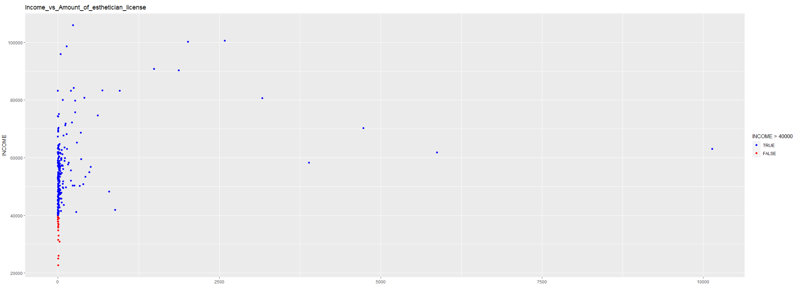
Result visualization

Slide 5
Data analysis
From the data graph, we can see that the amount of esthetician license in texas county below 40,000 is very low. However, once the 40,000$ mark past, the amount of esthetician license increased drastically, but not a linear increase. This concludes that the increase of income in a county only affect the amount of esthetician in the area when the income of the county is lower than 40,000$, once the county income surpassed 40,000$, those county starts to use esthetician care.

